Slide 1
Introduction to Angular 4
Day2

Slide 2
Day 2 Agenda
Reactive Programming in Angular
Forms
Dependency Injection
Http
Pipes
Notes:
http://blog.angular-university.io/functional-reactive-programming-for-angular-2-developers-rxjs-and-observables/

Slide 3
Reactive Programming in Angular
Brief Introduction to Reactive Programming with RxJS
Handling Events as Observables
Observable Http Requests
Observable in the router
Topics
Notes:
Notes: Agenda. Benefits of Reactive Programming. Give example of the Excel. Rx is library to implement reactive programming with a push of data and it is ported to diffferent languages

Slide 4
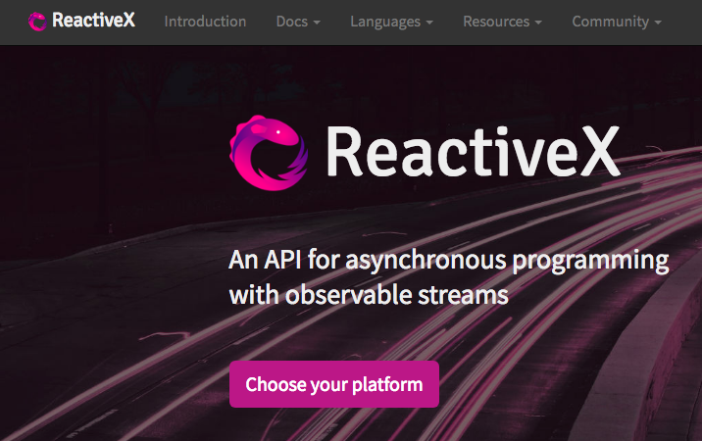
Rx libraries
Rx.NET - for .NET
RxCpp - for CPP
RxJS 5 - for JavaScript
Rx.rb - for Ruby
Rx.py - for Python
RxJava - for Java
Comes with Angular
Comes with Angular
http://reactivex.io/
http://reactivex.io/

Slide 5
RxJS - Main Player
Observable - a stream of data that pushes data over the period of time
Observer - consumer of the Observable stream
Subscribe - connect Observer with Observable
Operator - en route data transformation

Slide 6
Event Driven Push
Subscriber
Observer
push
Subscriber
Data Provider
Observable
push
Observer
Subscriber
push
Observer
Subscribe to messages from Observable and handle them by an Observer
Notes:
Mouse move , x y co-ordinates example

Slide 7
Observable/Observer
An Observable allows:
Subscribe/unsubscribe to its data stream
Emit the next element to the observer
Notify the observer about the error
Inform the observer about the stream completion
An Observer can have:
A function to handle the next object from the stream
A function to handle errors
A function to handle end-of-stream

Slide 8
An Operator
Observable
Observable
A transforming function
observableProducts.filter(product => product.price < 8)

Slide 9
Creating Observables
Observable.create(myObserver) - returns an Observable that can invoke methods on myObserver
Observable.of(1,2,3 ) - turns a sequence of values into and Observable
Observable.from(myArray) - converts and array or iterable into Observable
Observable.fromEvent(myInput, ‘keyup’) - converts an event into an Observable
Observable.interval(100) - emits an integer every second

Slide 10
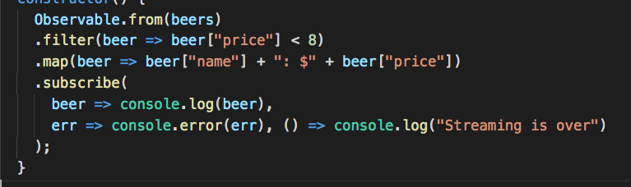
Array as Dataprovider
filter and map are operators
beer and err are observers
https://plnkr.co/edit/TV9djgA2BgQLTwvdRagG?p=preview

Slide 11
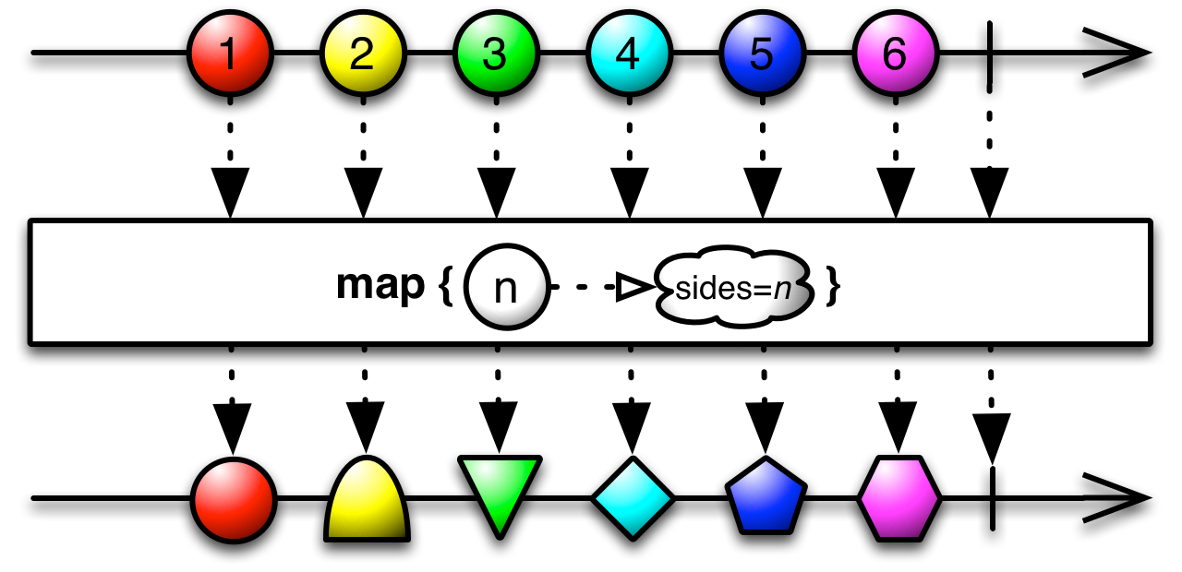
Marble Diagram

Slide 12
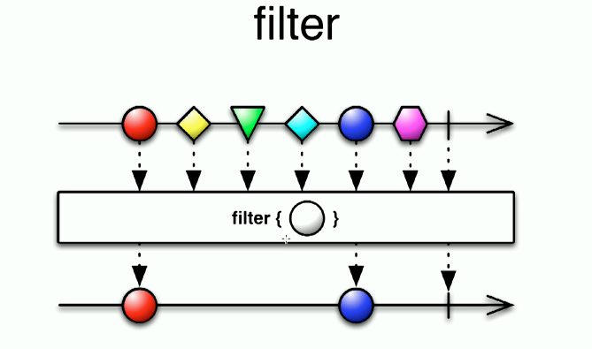
Marble Diagram

Slide 13
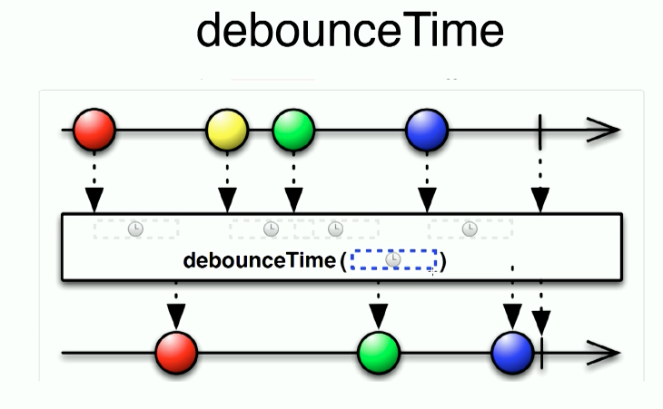
Marble Diagram

Slide 14
Observables in Angular Forms
valueChanges - the value of the form control changes
this.searchInput.valueChanges.subscribe(…)
statusChanges - status of the form control (valid/invalid) this.password.statusChanges.subscribe(…)
Notes:
https://github.com/susithrac/angular12hr/blob/master/unit4/observables/src/app/formcontrol/app.component.ts
Run the example and show the result in console

Slide 15
Http and Observables
DEMO
Notes:
https://plnkr.co/edit/CsoBDn?p=preview

Slide 16
Receiving Params in ActivatedRoute
Inject ActivatedRoute into a component to receive the route params during navigation
Use ActivatedRoute.params.subscribe() fro receiving multiple params over time
Notes:
Update this slide with the revised example from router

Slide 17
Forms

Slide 18
Forms are crucial
Form inputs are meant to modify data, both on the page and the server
Changes often need to be reflected elsewhere on the page
need to validate values
The UI needs to clearly state expectations and errors, if any
Dependent fields can have complex logic
Two types of Angular Forms
Template Driven Forms – All field values are submitted once and the values are retrieved and processed
Reactive Forms – The field values are monitored.

Slide 19
Angular 2 Forms
FormControls encapsulate the inputs in our forms and give us objects to work with them
Validators give us the ability to validate inputs, any way we’d like
Observers let us watch our form for changes and respond accordingly

Slide 20
Forms
Template Driven Forms
Use of component’s template
Unit Test against DOM and hence difficult
Reactive Forms
Use of component’s class
Create a Form model in TypeScript ( this must be in sync with the template )
Unit test against form model
Validation in Form Model

Slide 21
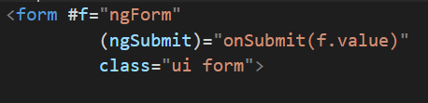
Steps - Build a Demo Form
NgForm includes the form tag in its selector (instead
of requiring you to explicitly add ngForm as an attribute).
if you import FormsModule, NgForm will get automatically attached to any <form> tags you have in your view.
There are two important pieces of functionality that NgForm gives us:
A FormGroup named ngForm
A (ngSubmit) output
Notes:
#v=thing syntax says that we want to create a local variable for this view.

Slide 22
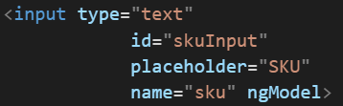
Steps - Build a Demo Form
Inputs and ngModel
The NgModel directive specifies a selector of ngModel
When ngModel is used without attribute value we are specifying
One way Databinging
Create a FormControl with name “sku”
Notes:
The NgModel directive specifies a selector of ngModel

Slide 23
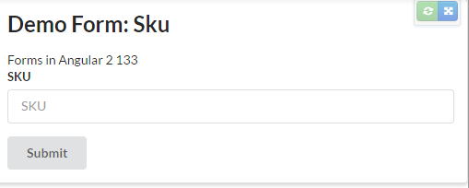
Simple Template Driven Form Demo
Plunker Form Demo

Slide 24
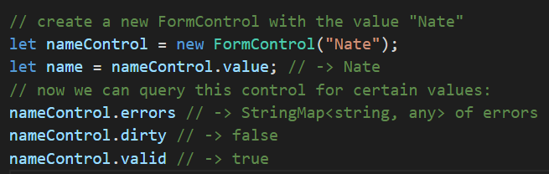

Reactive Forms - FormControl and FormGroup
A FormControl represents a single input field - it is the smallest unit of an Angular form.
FormControls encapsulate the field’s value, and states such as being valid, dirty (changed), or has errors.
Notes:
dirty indicates whether or not the user has entered any data into the form, even if they delete it

Slide 25
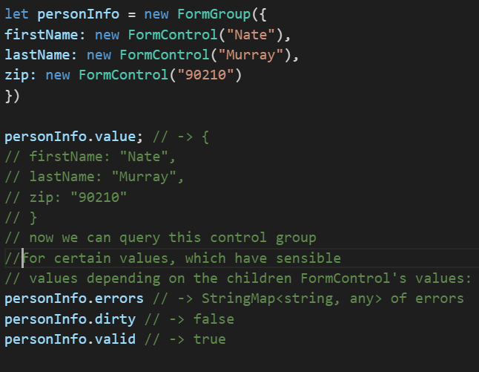
Reactive Forms - FormControl and FormGroup
Using FormGroup we can manage multiple FormControls
To check the validity of the all FormControls instead of iterating the array , FormGroup could be used.

Slide 26
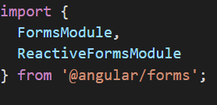
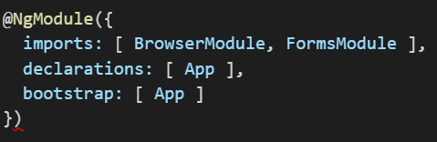
Steps - Build a Reactive Forms
Import the FormsModule or ReactiveFormsModule
FormsModule gives directives
ngModel and
NgForm
ReactiveFormsModule gives
formControlName
ngFormGroup

Slide 27
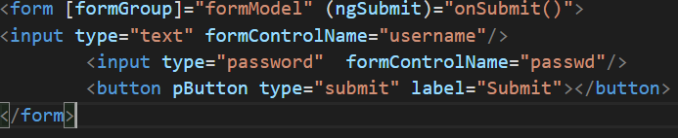
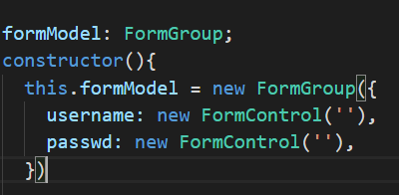
Steps - Build a Reactive Forms
formControlName – creates a new FormControl
formGroup – creates a new FormGroup and attaches to the formGroup in the component class
Notes:
- FormBuilder is Attached because of Dependency Injection.

Slide 28
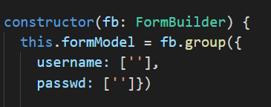
Steps - Build a Reactive Forms
Common way to customize Forms is thro FormBuilder.
We inject FormBuilder in the constructor. The two main functions of FormBuilder.
This avoids creating new FormControl in the constructor
Notes:
- FormBuilder is Attached because of Dependency Injection.

Slide 29
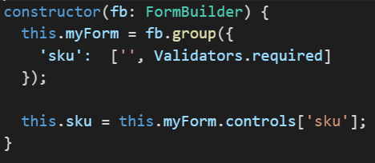
Validators
Validators are provided by Validators module
To use validator we need to do two things
Assign a validator to the FormControl Object
Check the status of the validator in the view and take actions accordingly.
Using FormControl
Using FormBuilder

Slide 30
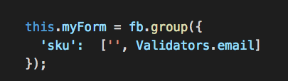
Validators
In-built Validators
required
maxLength
minLength
email (New in Angular 4)

Slide 31




Validators
Form Message
Field Message
Field Coloring
Specific Validation
https://plnkr.co/edit/RuMdrn?p=preview
Notes:
Change the sku to
"!myForm.controls['sku'].valid && sku.touched“
Since declaring each instance variables in tedious

Slide 32
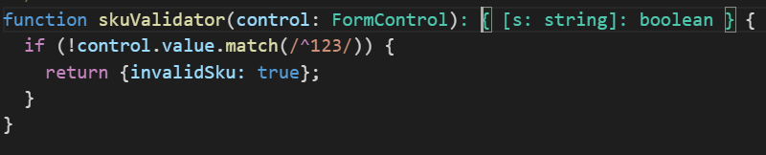
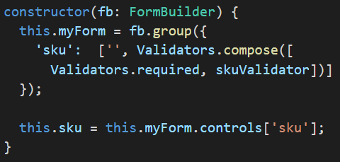
Custom Validators
Writing the validator
Assigning the validator to FormControl
https://plnkr.co/edit/7IDvOa?p=preview

Slide 33
Watching for Changes
Both FormControl and FormGroup have an EventEmitter that we can use to observe changes
EventEmitter is an Observable
To Watch for changes on a control
get access to the EventEmitter by calling control.valueChanges. Then we
add an observer using the .subscribe method
https://plnkr.co/edit/egK193?p=preview

Slide 34

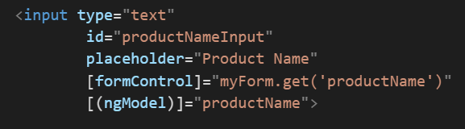
ngModel
NgModel is a special directive
It binds the model to the form
It implements two-way Data binding.
https://plnkr.co/edit/1c8b4I?p=preview

Slide 35
Dependency Injection (DI)

Slide 36
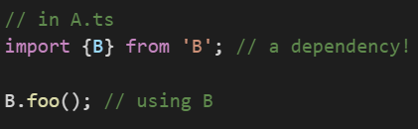
Dependency Injection
One of the common ways to access dependency is thro imports
Sometime this is not sufficient when
We want to share a single instance across the whole app (eg. Singleton Pattern)
We want to create a new instance of the class every time it is used (eg. Factory Pattern)
DI can solve the problems

Slide 37
Dependency Injection
Dependency Injection (DI) is a system to make parts of our program accessible to other parts of the
program - and we can configure how that happens.
Dependency injection in Angular has three pieces:
• the Provider (also often referred to as a binding) maps a token (that can be a string or a class)
to a list of dependencies. It tells Angular how to create an object, given a token.
• the Injector that holds a set of bindings and is responsible for resolving dependencies and
injecting them when creating objects
• the Dependency that is what’s being injected
Singleton DI - https://plnkr.co/edit/bIA3x7?p=preview
Notes:
The term Dependency Injection is used to describe both a design pattern (that used in many different frameworks) and also the specific implementation DI library that is built-in to Angular.
The major benefit of using dependency injection is that the client component doesn’t have to be aware of how to create the dependencies, all the component needs to know is how to interact with those dependencies.
@Injectable is needed when another service is Injectable from this service.

Slide 38
Providers
One of the neat things about Angular’s DI system is that there are several ways we can configure
the injection.
Inject a (singleton) instance of a class
Call any function and inject the return value of that function
Inject a value
Create an alias

Slide 39
Providers – Class Providers
Inject a (singleton) instance of a class
The first provide is the token that we use to identify the injection and the second useClass is how and what to inject.
So here we’re mapping the MyComponent class to the MyComponent token. The names need not match, but it is a convention
The injector will create a singleton behind the scenes and return the same instance every time we inject it.
First time constructor will be called and only once
Class Provider’s properties are provide, useClass and multi
Notes:
the injector will create a singleton behind the scenes and return
the same instance every time we inject it .
Of course, the first time it is injected, it hasn’t been instantiated yet, so when creating the
MyComponent instance for the first time, the DI system will trigger the class constructor method.
Here token can be different , but it is convention to use the same token. In the snippet shown we need to pass a string to the constructor. For this we need to use factory

Slide 40
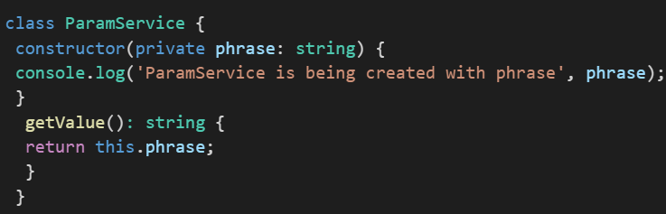
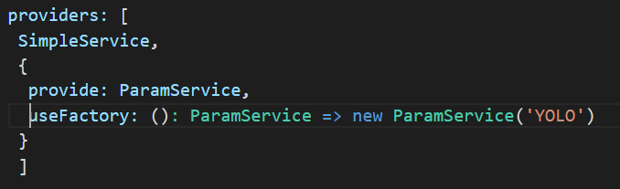
Providers – Factory Provider
Call any function and inject the return value of that function (Using a Factory)
Using a factory is the most powerful way to create injectables, because we can do whatever we want within the factory function.
Factor Provider’s properties are provide, useFactory, deps and multi

Slide 41

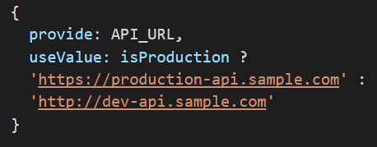
Providers- Value Provider
Inject a Value
This is useful when we want to register a constant that can be redefined by another part of the application or even by environment (e.g. test or production).
Value Provider’s properties are provide, useValue and multi

Slide 42
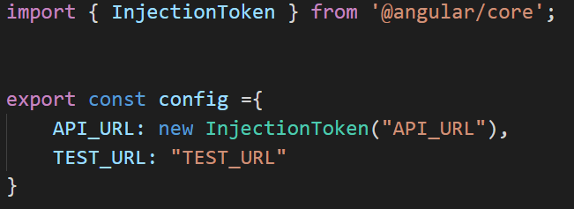
Providers ( InjectionToken)
When using simple types (string) as providers there is a chance of naming collision
Angular 4 provides with InjectionToken to resolve this
Replace hard coded strings with an instance of InjectionToken
Notes:
It is a practise to use class for token when using service classes but you can use InjectionToken as well.

Slide 43

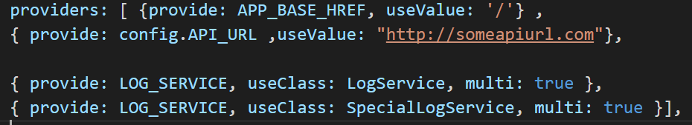
Resolving Dependency with multiple objects
The class provider can be configured to deliver an array of objects to resolve a dependency, which can be useful if you want to provide a set of related services that differ in how they are configured.
To provide an array, multiple class providers are configured using the same token and with the multi property set as true

Slide 44
Providers
4. Create an alias
We can also make an alias to reference a previously registered token

Slide 45
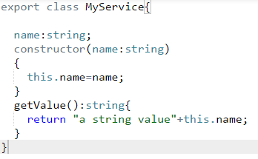

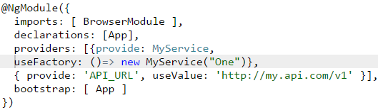
Dependency Injection in Apps
Create the service class
Declare the dependencies on the receiving component and
Configure the injection (i.e. register the injection with Angular in our NgModule)
1
2
3
https://plnkr.co/edit/bIA3x7?p=preview

Slide 46
HTTP

Slide 47
HTTP
Angular comes with its own HTTPClient library to access external APIs.
HTTPClient requests are asynchronous
In JavaScript there are three approaches
Promises
Callbacks
Observables
In Angular the preferred method is calling via Observables

Slide 48
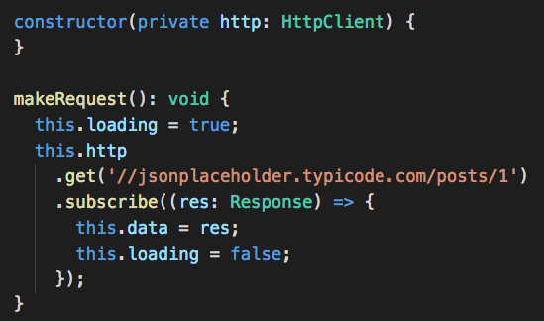
Basic Example of http
Import HttpClientModule, HttpClient and Response from @angular/common/http
Inject the key module HttpClient
Call the request method which returns an Observable
https://plnkr.co/edit/0v2iv5?p=info

Slide 49
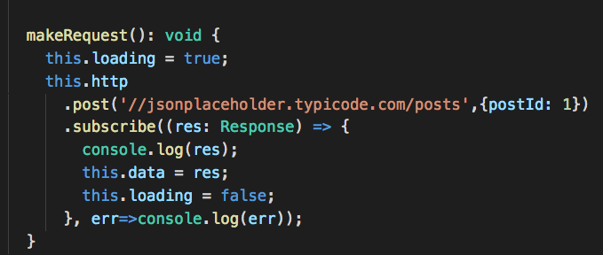
@angular/common/http API
Making POST request is similar to get but with a additional parameter: a body
https://plnkr.co/edit/tAIXzW

Slide 50
@angular/common/http API
http.put PUT take a URL and a body
http.delete DELETE both take a URL (no body)

Slide 51
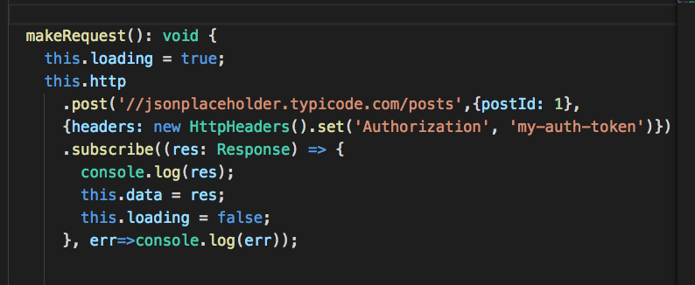
Headers
The HttpHeaders class is immutable, so every set() returns a new instance and applies the changes.

Slide 52
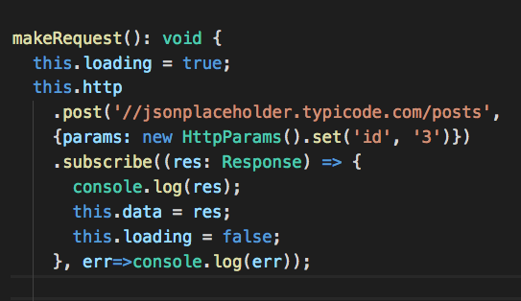
HttpParams
The HttpParams class is immutable, so every set() returns a new instance and applies the changes. You can chain set functions.

Slide 53
Transforming Data with pipes

Slide 54
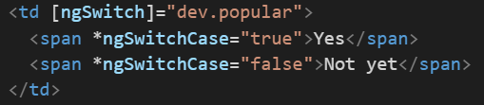
Transforming Data with Pipes
Just like the filters in AngularJS, pipes are intended to encapsulate all the data transformation logic.
In this example, depending on the value of the popular we show different data using ngSwitchCase. To avoid this redundancy, pipes are used

Slide 55
Stateless Pipes
Stateless pipes are pure functions that flow input data through without remembering anything or causing detectable side-effects.
Most pipes are stateless
Notes:
The name that we pass to the @Pipe decorator determines how we should reference it in templates.

Slide 56
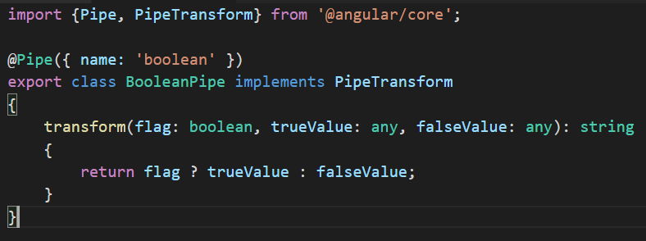
Stateless Pipes
The pipe will accept three arguments: a value that should be transformed, a string that should be displayed when the value is truthy, and another string that should be displayed in case of a falsy value.
The name that we pass to the @Pipe decorator determines how we should reference it in templates.
https://plnkr.co/edit/W3L2Hu?p=preview
Notes:
The name that we pass to the @Pipe decorator determines how we should reference it in templates.

Slide 57
Angular’s built-in pipes
CurrencyPipe: This pipe is used for formatting currency data. As an argument, it accepts the abbreviation of the currency type (that is, "EUR", "USD", and so on).
DatePipe: This pipe is used for the transformation of dates.

Slide 58
Angular’s built-in pipes
DecimalPipe: This pipe is used for transformation of decimal numbers. The argument it accepts is of the following form
:"{minIntegerDigits}.{minFractionDigits}-{maxFractionDigits}".
JsonPipe: This transforms a JavaScript object into a JSON string.

Slide 59



Angular’s built-in pipes
LowerCasePipe: This transforms a string to lowercase.
UpperCasePipe: This transforms a string to uppercase.
PercentPipe: This transforms a number into a percentage.
TitlecasePipe - New in Angular 4

Slide 60

Angular’s built-in pipes
SlicePipe: This returns a slice of an array. The pipe accepts the start and the end indexes of the slice.
AsyncPipe: This is a stateful pipe that accepts an observable or a promise

Slide 61
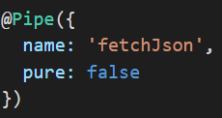
Stateful Pipes
Stateful pipes are those which can manage the state of the data they transform.
A pipe that creates an HTTP request, stores the response and displays the output, is a stateful pipe.
Stateful Pipes should be used cautiously.
The @Pipe decorator accepts an object literal of the { name: string, pure?: boolean } type, where the default value for the pure property is true.
https://embed.plnkr.co/dheWxs/
Stateful Pipe
Notes:
This means that, when we define any given pipe, we can declare whether it is stateful or stateless. The pure property is important because, in case the pipe is stateless (that is, it returns the same result in case it is applied over the same value with the same set of arguments), the change detection can be optimized.

Slide 62
Async Pipe

Slide 63
Angular’s AsyncPipe
Angular's AsyncPipe transform method accepts an observable or a promise as an argument.
Once the argument pushes a value (that is, the promise has been resolved or the subscribe callback of the observable is invoked), AsyncPipe will return it as a result.

Slide 64
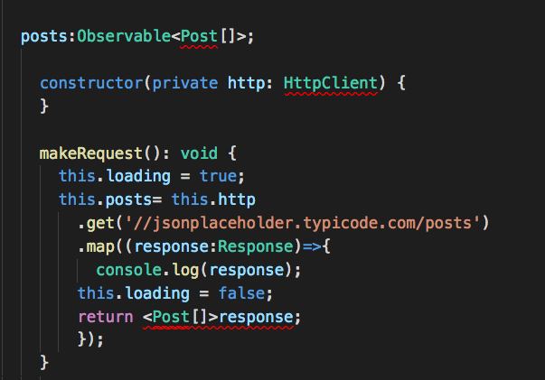
Angular’s AsyncPipe
AsyncPipe with Observables
https://plnkr.co/edit/1TpVbD?p=info
Notes:
For Angular 4.4
this.posts = this.http.get<Post[]>("http://jsonplaceholder.typicode.com/posts")
Map can be removed

Slide 65
End of Day 02

